Slide 1

POULTRY SCIENCE:
Animal Welfare
Unit 16

Slide 2
Poultry Science:
Animal Welfare
Unit 16: Segment 1
Animal Welfare Overview

Slide 3
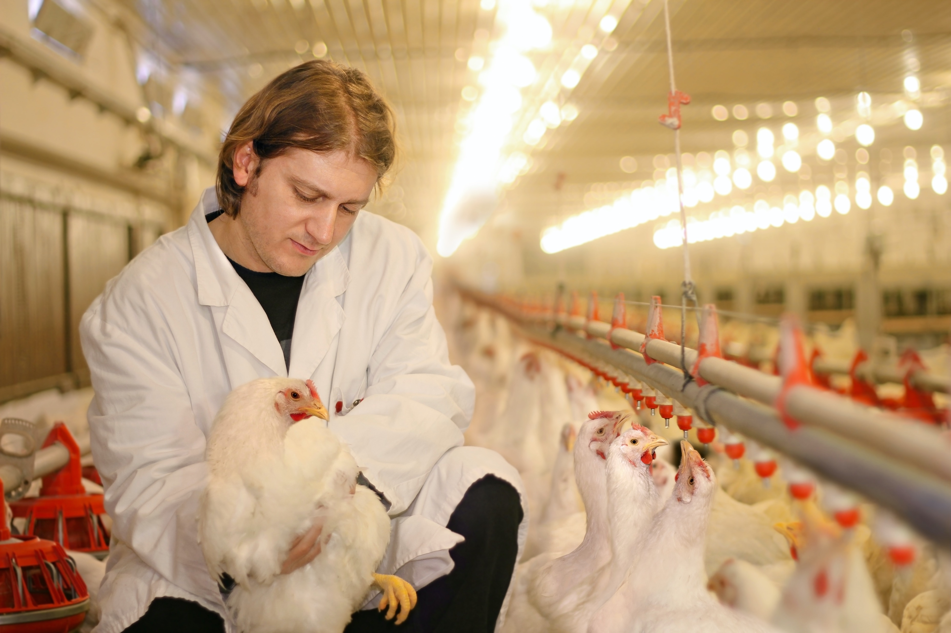
Animal Welfare
Animal Welfare is dependent on:
Mental needs
Psychological needs
Cognitive needs

Slide 4
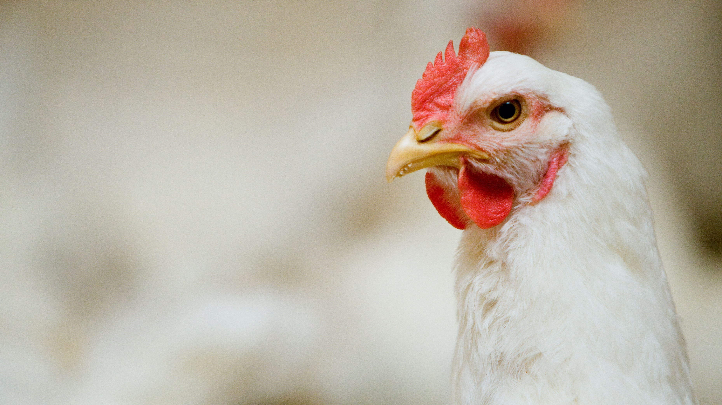
Animal Welfare
Animal Welfare Rights:
Freedom from hunger & thirst
Freedom from discomfort
Freedom from pain, injury, or disease
Freedom to express normal behavior
Freedom from fear and distress

Slide 5
Animal Welfare:
Broilers & Broiler Breeders
Consumers want to be sure that all animals being raised for food are treated with respect and are properly cared for during their lives.
The people and companies involved in raising chickens for food share the public’s concern.
They recognize that they have an ethical obligation to make sure that the animals on their farms are well cared for.

Slide 6
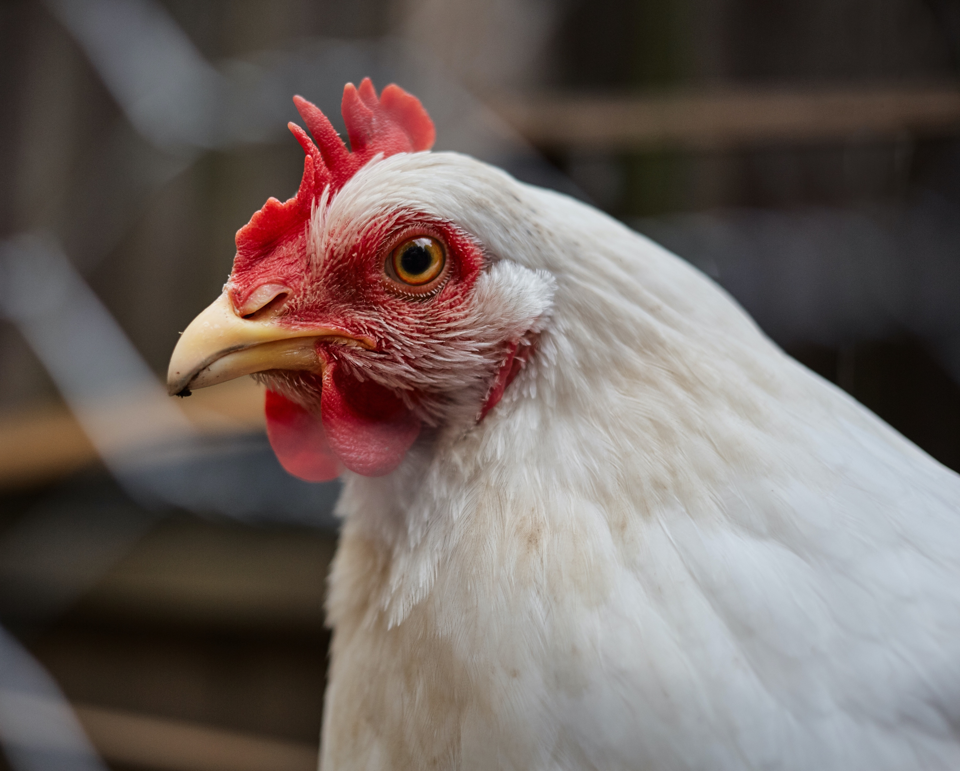
Animal Welfare:
Broilers & Broiler Breeders
The chicken industry has come together on a specific set of expectations that will ensure that the birds they raise are taken care of with the highest standards starting at hatch.
Healthy, top-quality animals are needed for food, proper treatment is not only an ethical obligation, but it just makes good business sense.

Slide 7
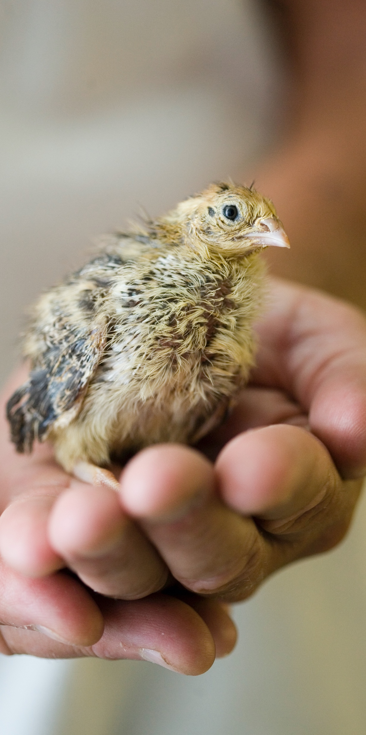
Animal Welfare:
Broilers & Broiler Breeders
Carefully formulated feed, access to a plentiful supply of clean water, adequate room to grow, professional veterinary attention, and proper handling are all important factors in the management of broiler flocks and the production of high-quality food products.

Slide 8
Animal Welfare:
Broilers & Broiler Breeders
The Efforts:
To assist the people and the companies who produce and process chickens for food, the National Chicken Council developed the NCC Animal Welfare Guidelines and Audit Checklist which have been widely adopted within the chicken industry. These guidelines cover every phase of the chicken’s life and offers science-based recommendations for proper treatment. Among other things, it includes chapters on:
Corporate commitment
Hatchery operations
Proper nutrition and feeding
Appropriate comfort and shelter
Health care and monitoring
Ability to display most normal behaviors
On-farm best practices
Catching and transportation
Processing
Breeder operations (if present)

Slide 9



Slide 10
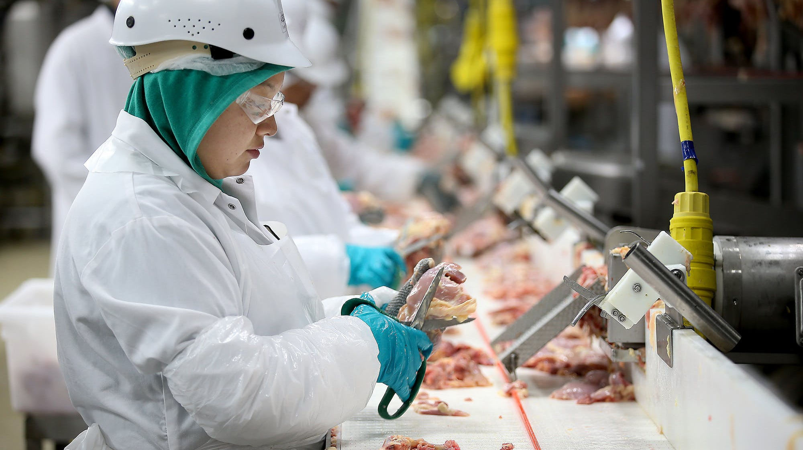
Animal Welfare:
Poultry Processing
Upon arrival to the processing plant, birds are protected from the sun and are equipped with fans and evaporative cooling systems to maintain bird comfort and welfare.
During unloading and shackling, employees must work quietly, calmly, and efficiently to ensure all birds are shackled properly while maintain bird welfare.
  Employees undergo training for this!

Slide 11
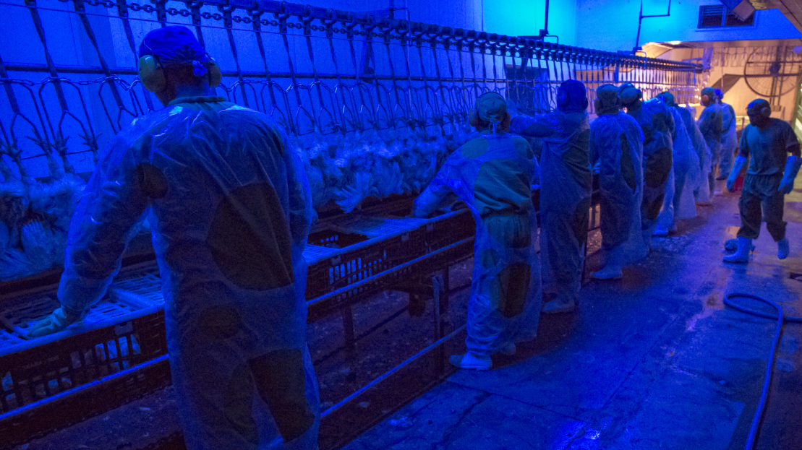
Animal Welfare:
Poultry Processing
Birds are also kept in low, blue light, which has been shown to keep them calmer and less likely to get excited, risking injury to themselves and other birds.
Time from shackling area to the stunning cabinet should not exceed 60 seconds, and breast rubs are utilized to keep the birds calm as well.
Electrical stunning renders the bird unconscious and unable to feel pain while protecting final meat quality during bleed-out.

Slide 12
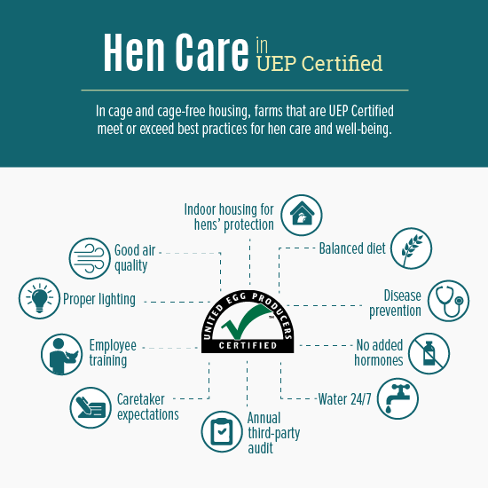
Animal Welfare: Laying Hens
United Egg Producers (UEP) is a cooperative of U.S. egg farmers working collaboratively to address legislative, regulatory and advocacy issues impacting the industry through active farmer-member leadership, a unified voice and partnership across the agriculture community.
UEP’s farmer-members work to provide for the health and well-being of their birds; to produce safe, nutritious, high-quality eggs; and to manage their farms responsibly with best on-farm management practices.
UEP manages the National Egg Safety Center, a leading resource for consumer and industry information on the safe production of eggs and prevention of disease.
Formed in 1968, UEP members represent 95% of US egg production.

Slide 13



Animal Welfare:
Leading Poultry Companies
Listed in no particular order, these poultry companies are considered to be three of the top industry leaders taking strides in animal welfare.
Click each one to see what they’re doing and compare!

Slide 14
Poultry Science:
Animal Welfare
Unit 16: Segment 2
Alternative Housing Methods

Slide 15
Conventional Cage Housing
Hens are housed inside climate-controlled barns in stacked rows of cages. Each cage gives birds continual access to water and food.
The cage has wire mesh floors that allow manure to drop through to a belt below, which keeps manure away from the birds, as well as their eggs, food and water.
After a hen lays an egg, it gently rolls off the slightly-sloped mesh flooring onto an egg-collection belt.
The belt moves the egg to processing, where it is checked for imperfections, cleaned and packaged.

Slide 16
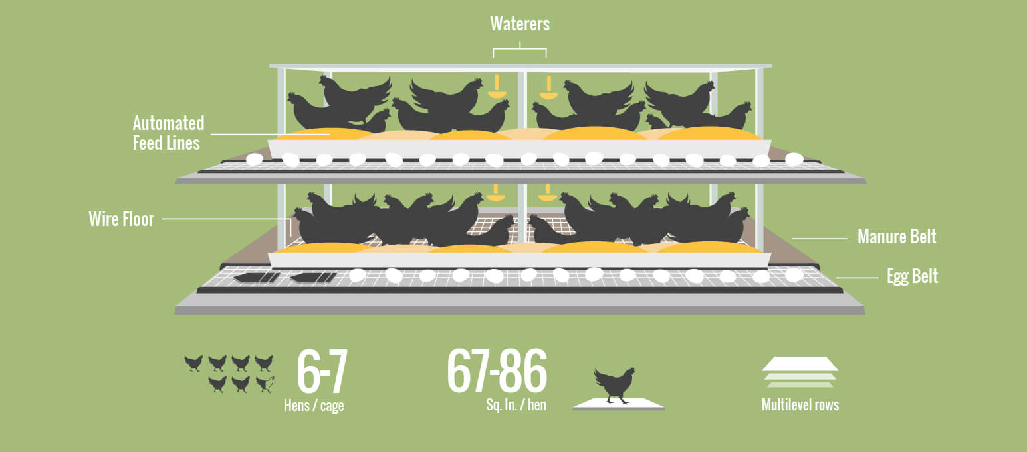
Conventional Cage Housing

Slide 17
Cage-Free Housing
Cage-free eggs are laid by hens that are able to roam vertically and horizontally in indoor houses and have access to fresh food and water.
Cage-free systems vary from farm-to-farm and can include multi-tier aviaries. They must allow hens to exhibit natural behaviors and include enrichments such as scratch areas, perches and nests.
Hens must have access to litter, protection from predators and be able to move in a barn in a manner that promotes bird welfare.
Manure belts help keep manure away from birds.
Most of the time, hens lay the eggs in the nest box, where the eggs then rolls off the slightly-sloped floor onto a collection belt. The belt moves the egg to processing. Eggs can also be laid in the litter or elsewhere in the barn, and then they must be collected by hand.

Slide 18
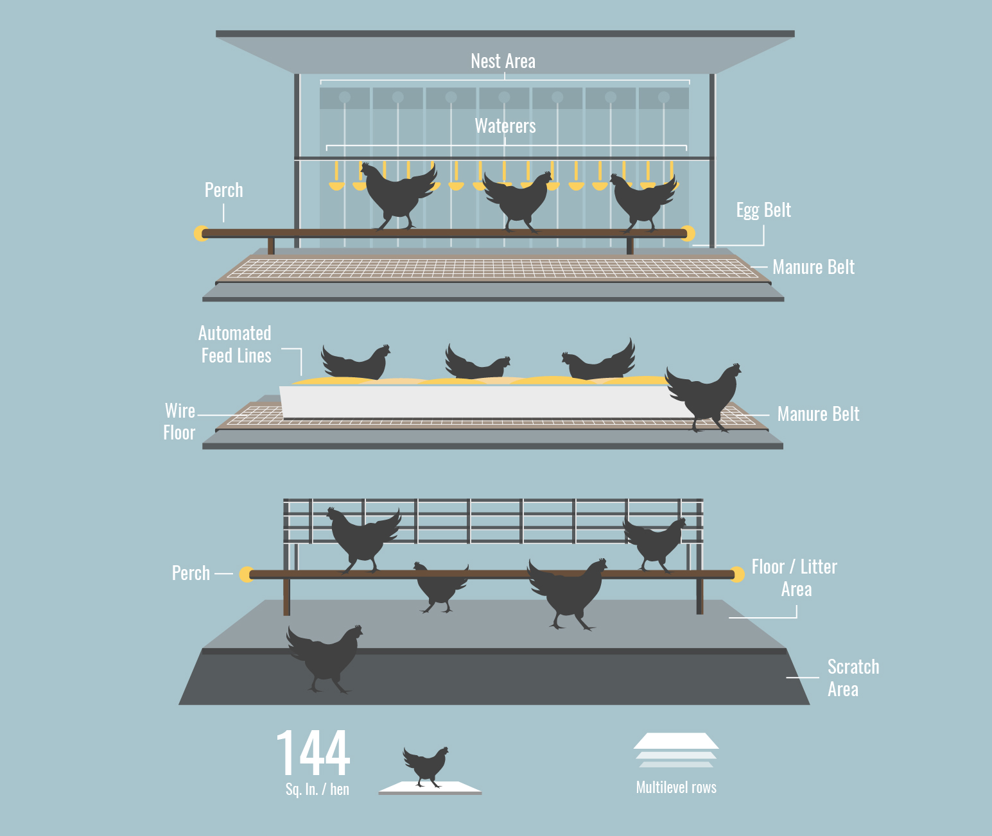
Cage-Free Housing

Slide 19
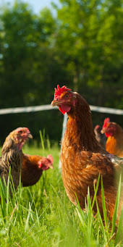
Free-Range/Free-Roaming/Pastured
Free access to outdoors
Relatively poor performance compared to commercial conditions
No legal definition of what these terms mean
Susceptible to:
  Predators
  Weather
  Egg hiding
  Landscape damage
  Disease exposure
  These factors lead to the much higher prices of non-conventionally raised eggs that you see in the grocery store!

Slide 20
Poultry Science
Curriculum References
Jessica Fife, UGA Dept. of Poultry Science Outreach Coordinator, UGA Dept. of Agricultural Leadership, Education, & Communication MAEE Candidate
Barry Croom, UGA Dept. of Agricultural Leadership, Education, & Communication Professor
Ashley Yopp, UGA Dept. of Agricultural Leadership, Education, & Communication Assistant Professor
Georgia Agriculture Education
Andrew Benson, UGA Dept. of Poultry Science Assistant Professor
Brian Jordan, UGA Dept. of Poultry Science Assistant Professor, UGA College of Veterinary Medicine Assistant Professor
University of Arkansas Bumpers College of Poultry Science – Poultry Science Dual Curriculum Course
Julia Gaskin, UGA Dept. of Crop and Soil Sciences Sr. Public Service Associate
Glendon Harris, UGA Dept. of Crop and Soil Sciences Professor & Extension Agronomist
Brian Kiepper, UGA Dept. of Poultry Science Associate Professor
Claudia Dunkley, UGA Dept. of Poultry Science Public Service Associate
Casey Ritz, UGA Dept. of Poultry Science Professor
USPOULTRY & USPOULTRY Poultry Science Curriculum
Tom Tabler, Mississippi State University Department of Poultry Science Extension Professor
Jacquie Jacob, University of Kentucky
Jeanna Wilson, UGA Dept. of Poultry Science Professor
Kelly Sweeney, UGA Dept. of Poultry Science Ph.D Candidate
Merck Veterinary Manual
University of Maryland Extension
Poultry Hub
Brian Fairchild, University of Georgia Department of Poultry Science Professor
Centers for Disease Control
National FFA Organization

